Slide 1

DriverPass System Analysis
CS 255 Project Two
Shayal Singh
Notes:
[No speaker notes required for this slide.]

Slide 2

System Requirements
• [Students can create accounts and log in • Students can schedule driving lessons • Students can take online practice tests • Secure online payments • Easy-to-use and reliable system]
Notes:
[The functional requirements for the DriverPass system include allowing students to create accounts, log in securely, schedule driving lessons, take online practice tests, and make payments. These features are essential because they directly support the main services that DriverPass provides to its customers.
The nonfunctional requirements focus on how the system performs rather than what it does. The system must be reliable, secure, and easy to use. It must protect personal information and payment details, and it should work smoothly without frequent downtime. These requirements ensure that customers have a positive experience and that DriverPass can operate efficiently and securely.]

Slide 3
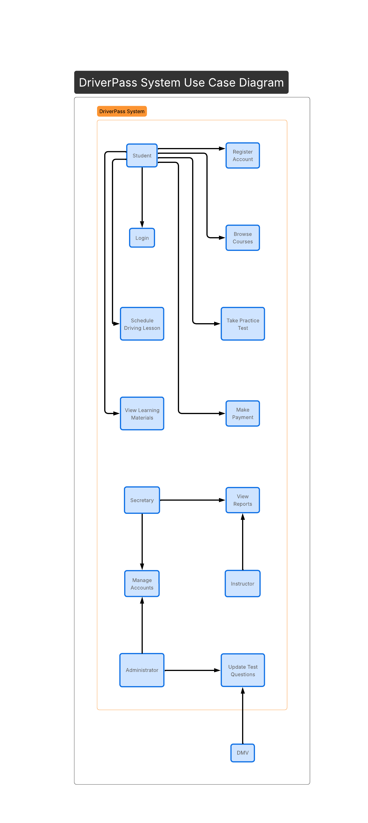
Use Case Diagram
Notes:
[This diagram shows who can use the system and what they can do. Students can register, log in, schedule lessons, take practice tests, view learning materials, and make payments. Office staff can manage accounts and view reports. Instructors can view lesson-related reports. Administrators manage system data and update test questions. This design ensures everyone has access to the features they need.]

Slide 4
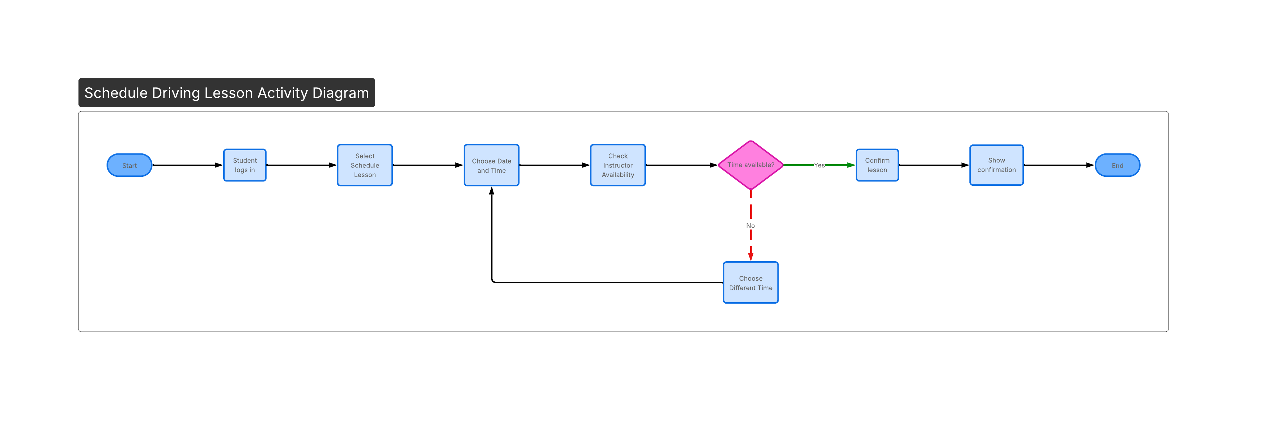
Activity Diagram
Notes:
[This diagram breaks down the process of scheduling a driving lesson. The student logs into the system, selects a lesson time, and the system checks instructor availability. If the time is available, the lesson is confirmed. If the time is not available, the student selects a different time. This design ensures that lessons are scheduled efficiently and without conflicts, meeting DriverPass’s need for simple and accurate scheduling.]

Slide 5
Security
• [Secure user logins • Protected personal information • Restricted access by role • Safe payment processing]
Notes:
[Security was carefully considered in this design. Users must log in with a username and password before accessing the system. Personal information is protected, and only authorized users can access certain features based on their role. Payments are handled securely to protect customer data. These measures help ensure that customer information remains safe and private.]

Slide 6
System Limitations
• [Requires internet access • Limited customization options • Depends on system availability]
Notes:
[The system requires an internet connection in order to be used. Some features may have limited customization. If the system is temporarily unavailable due to maintenance or technical issues, users may not be able to access it. These limitations are common for online systems and can be managed with proper planning.]

